Slide 1
Strategy Pattern
Head First Design Patterns
PPT By :Melvin Yu

Slide 2

It started with a simple SimUDuck app
Joe works for a company that makes a highly successful duck pond simulation game, SimUDuck. The game can show a large variety of duck species swimming and making quacking sounds. The initial designers of the system used standard OO techniques and created one Duck superclass from which all other duck types inherit.

Slide 3
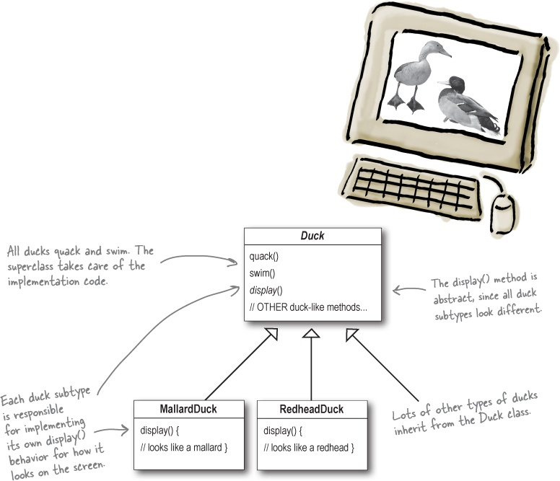

Slide 4
Their company is in a lot of pressure due to other competitors rising up.
They need something really impressive to show at the upcoming shareholders meeting in Maui next week.
now we need the ducks to FLY

Slide 5
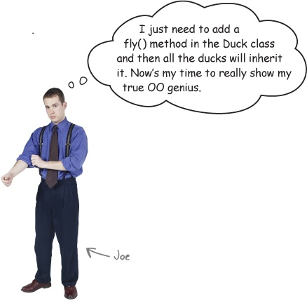

Slide 6
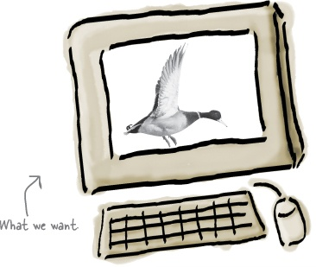
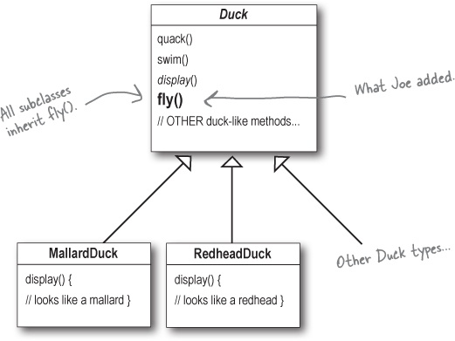

Slide 7
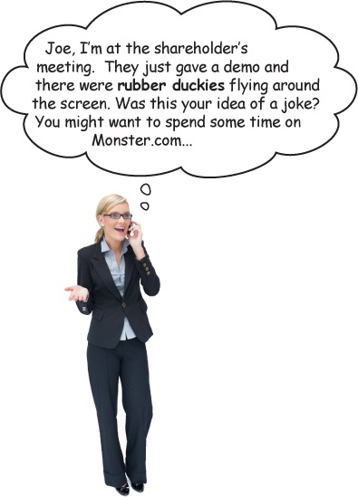



Slide 8
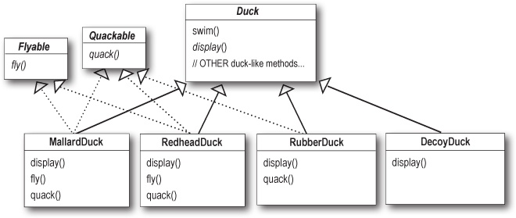
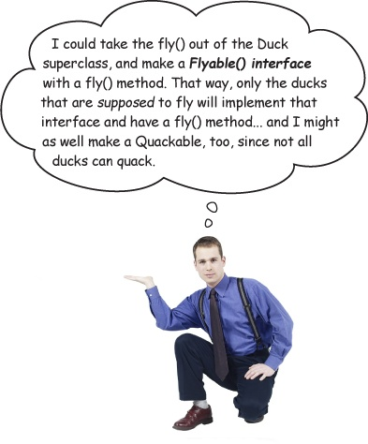

Slide 9
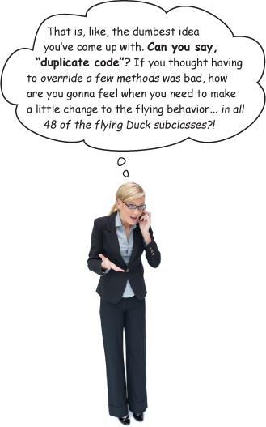

Slide 10
Strategy
a class behavior or its algorithm can be changed at run time. This type of design pattern comes under behavior pattern.
we create objects which represent various strategies and a context object whose behavior varies as per its strategy object. The strategy object changes the executing algorithm of the context object.

Slide 11
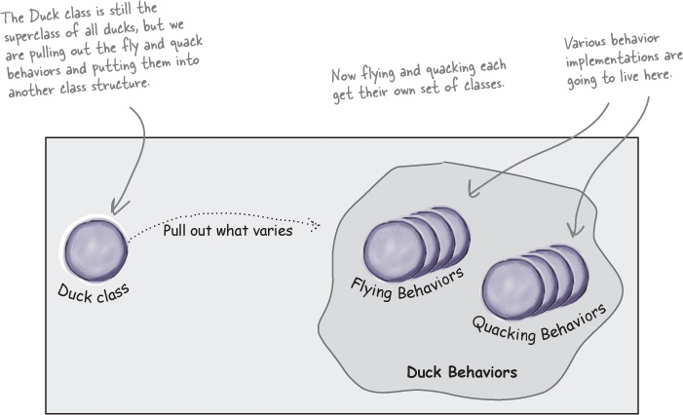

Slide 12
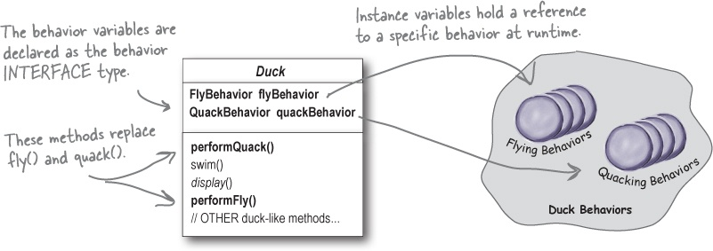
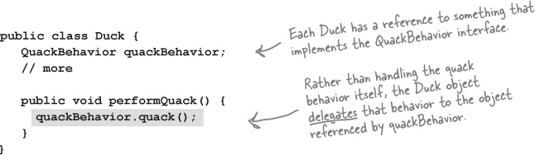

Slide 13
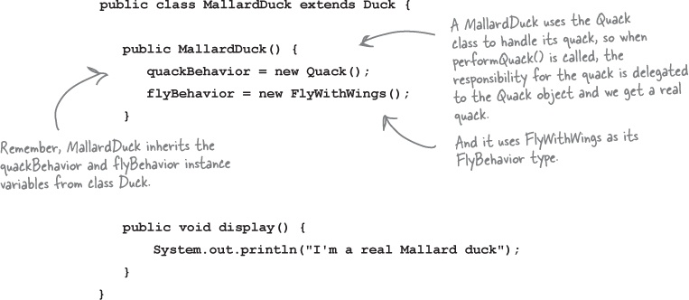

Slide 14
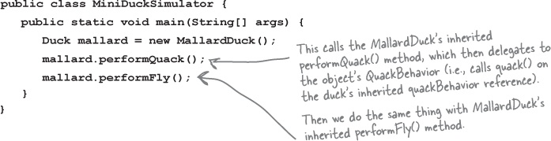
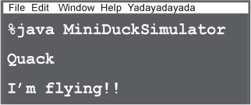

Slide 15
